Slide 1

Unit-8: Advanced Microprocessor
Microprocessor and Interfacing
(MPI)
GTU # 3160712
Prof. Swati R Sharma
Computer Engineering Department
swati.sharma@darshan.ac.in
(O) 9727747317

Slide 2
Subject Overview
Sr. No. | Unit | % Weightage
1 | Introduction to Microprocessor | 8%
2 | Microprocessor Architecture and Operations | 7%
3 | 8085 Microprocessor | 12%
4 | Assembly Language Programming Basics | 13%
5 | 8085 Assembly Language Programs | 12%
6 | Stack & Subroutines | 13%
7 | I/O Interfacing | 20%
8 | Advanced Microprocessors | 15%

Slide 3
Subject Overview
Sr. | Unit | Reference Books
1 | Introduction to Microprocessor | Microprocessor Architecture, Programming, and Applications with the 8085 Ramesh S. Gaonkar, Penram International
2 | Microprocessor Architecture and Operations
3 | 8085 Microprocessor
4 | Assembly Language Programming Basics
5 | 8085 Assembly Language Programs
6 | Stack & Subroutines
7 | I/O Interfacing
8 | Advanced Microprocessors | Advanced Microprocessors Daniel Tabak, TMH

Slide 4

Looping
Topics to be covered
Introduction to 8086
8086 logical block diagram
8086 Segmentation
8086 Pin functions
Minimum and Maximum mode
80286/80386:
Overview and architecture
Programming model,
Data types and instruction set,
Segments and its types
Segment descriptor
Descriptor table and selectors

Slide 5
Introduction to 8086

Slide 6
Introduction to 8086
8086 is a 16-bit processor, which implies that
16-bit data bus
16-bit ALU
16-bit registers
8086 has a 20-bit address bus can access up to 2²⁰ memory locations.
( 2²⁰=1048576 bytes =1 MB)
It can support up to 64K I/O ports. (2¹⁶ I/O ports:2¹⁶=65536)
8086 has 256 vectored interrupt.
8086 contains powerful instruction set, that also supports multiply and divide operation.

Slide 7
Introduction to 8086
8086 can operate in two modes:
Minimum mode: A system with only one processor i.e.8086
Maximum mode: A system with multiple processors.
e.g. 8086 + math co-processor(8087),
8086+ I/O processor (8089)
8086 uses memory segmentation. Segmentation means dividing memory into logical components.
In 8086 memory is divided into 16 segments of capacity 2¹⁶ bytes each and used as code, stack, data and extra segment respectively.

Slide 8
8086 Architecture
Block Diagram

Slide 9
Memory Interface
Σ
6
5
Instruction
stream
byte
queue
4
BIU
ES
3
CS
2
SS
1
DS
IP
Control System
8086 Architecture
15
0
15
8
7
0
AX
AH
AL
BX
BH
BL
Arithmetic logic unit
EU
CX
CH
CL
DX
DH
DL
SP
BP
Operands
SI
Flags
DI

Slide 10
8086 Architecture
In 8086 CPU is divided into two independent functional units:
BIU (Bus Interface Unit)
EU (Execution Unit)
Dividing the work between these two units speeds up the processing.

Slide 11
Components: BIU(Bus Interface Unit)
Instruction Queue:
It holds the instruction bytes of the next instruction to be executed by EU(Execution Unit).
Address Generator: Generates 20-bit of physical address.
Σ
6
5
Instruction
stream
byte
queue
4
BIU
ES
3
CS
2
SS
1
DS
Segment Register:
Four 16-bit register that provides powerful memory management mechanism
ES (extra segment), CS (code segment),
SS (stack segment) , DS (data segment).
IP
Instruction Pointer:
Register that holds 16-bit address or offset of next code byte within code segment.
15
0

Slide 12
Task of BIU
Fetch instructions from memory.
Read/write instructions to/from the memory.
Input/output of data to/from peripheral ports.
Address generation for memory reference.
Queuing instructions.
Thus, BIU handles all transfer of data and address.

Slide 13
Components: EU(Execution Unit)
EU has 4 general purpose 16-bit register i.e. AX, BX, CX, DX
each register is the combination of two 8-bit register.
Performs various internal operations.
Contains 16-bit ALU, that performs add, subtract, increment, decrement, compliment, shift, AND, OR, XOR etc.
Control System
15
8
7
0
AX
AH
AL
BX
BH
BL
EU
CX
CH
CL
Arithmetic logic unit
DX
DH
DL
SP
The 16-bit flag register of 8086 contains 9 active flags (6 conditional & 3 control flags), other 7 flags are undefined.
SI (Source Index) and DI (Destination Index) are used for string related operation and for moving block of memory from one location to another.
BP
Operands
Operand register: 16-bit register used by the control register to hold the operands temporarily.
SI
Flags
DI
Stack pointer: It always points to the top of the stack. Used for sequential access of stack segment.
Base pointer: used for indirect addressing.

Slide 14
Task of EU (Execution Unit)
Decodes the instruction.
Executes decoded instructions.
Tells BIU from where to fetch the instruction.
EU takes care of performing operation on the data.
EU is also known as execution heart of the processor.

Slide 15
Memory Interface
Σ
6
5
Instruction
stream
byte
queue
4
BIU
ES
3
CS
2
SS
1
DS
IP
Control System
8086 Architecture
15
0
15
8
7
0
AX
AH
AL
BX
BH
BL
Arithmetic logic unit
EU
CX
CH
CL
DX
DH
DL
SP
BP
Operands
SI
Flags
DI

Slide 16
GTU Exam Questions
Sr. | Questions | Marks | Year
1. | Draw and explain internal architecture diagram of 8086 microprocessor. | 7 | S’18 W’19
2. | Differentiate 8085 microprocessor with 8086 microprocessor. | 4 | S’18
3. | What are the addressing capacity of 8085 microprocessor and 8086 microprocessor? | 3 | S’18

Slide 17
Segment Register in 8086

Slide 18
Segment Register in 8086
Code Segment (CS): Stores executable program.
Data Segment (DS): Contains data used by a program. Data can be accessed from this by an offset address.
Stack Segment (SS): Defines an area of memory used for the stack.
Extra Segment (ES): ES an additional data segment.

Slide 19
Segmentation in 8086

Slide 20
Segmentation in 8086
What is Segment?
An area in memory.
What is Segmentation?
The process of dividing memory into segments of various sizes is called Segmentation.

Slide 21

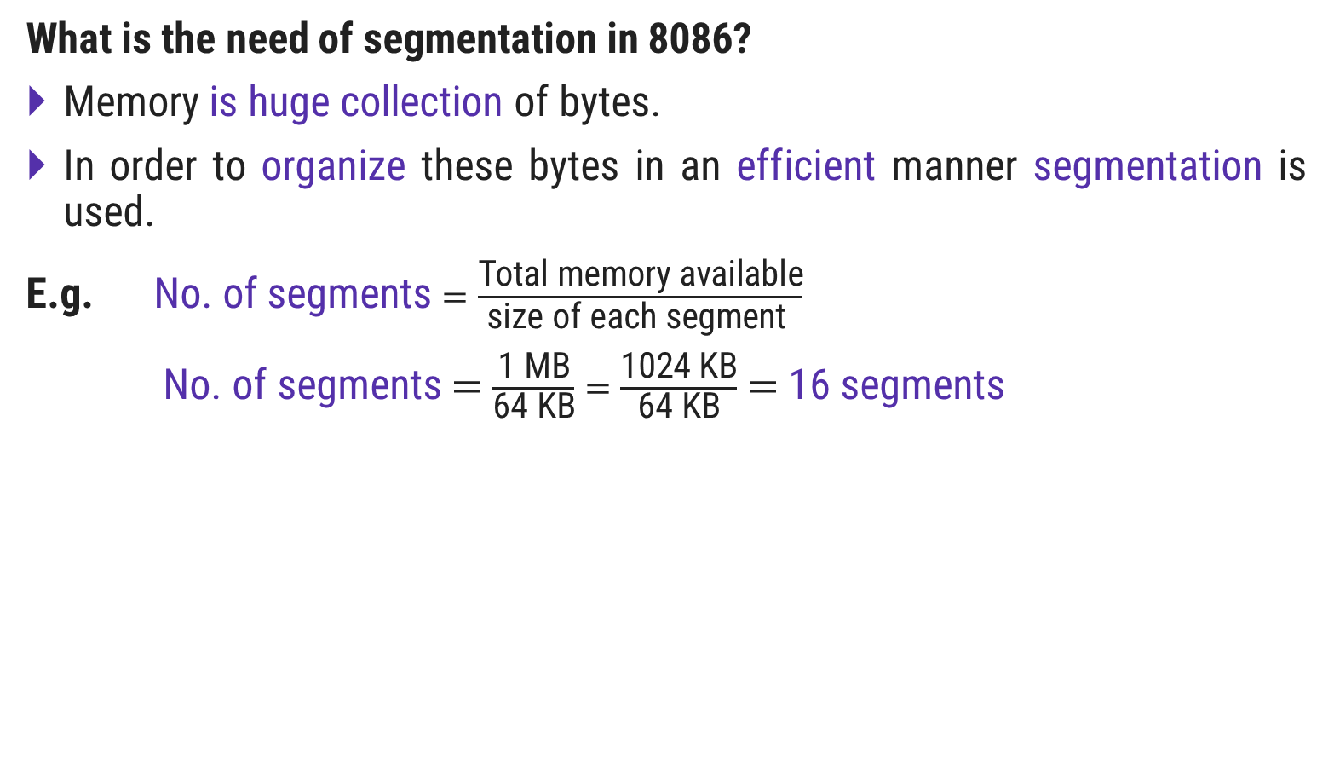
What is need of segmentation in 8086?
What is the need of segmentation in 8086?
Memory is huge collection of bytes.
In order to organize these bytes in an efficient manner segmentation is used.
E.g. No. of segments $=\frac{\text{Total} \text{memory} \text{available}}{\text{size} \text{of} \text{each} \text{segment} }$
No. of segments $=$ $\frac{\text{1 }\text{MB}}{\text{64 }\text{KB}}=$ $\frac{\text{1024 }\text{KB}}{\text{64 }\text{KB}}$ $=$16 segments
1 MB
15
14
13
12
11
10
9
8
7
6
5
4
3
2
1
0
$$\text{64}\text{KB}$$

Slide 22
Segmentation in 8086
Intel 8086 has 20 lines address bus.
With 20 address lines, the memory that can be addressed is 2²⁰ bytes.
2²⁰ = 1,048,576 bytes
1 MB = 1111 1111 1111 1111 1111
= FFFFF H

Slide 23
Segmentation in 8086
How many segments can be accessed at a time in 8086?
In 8086, at a time only 4 segments can be accessed.
i.e. 64 KB * 4 = 256 KB of memory can be accessed at a time.
In 8086, memory address is ranging from 00000 H to FFFFF H.
Bit-Size of each Segment Register is of 16-bit.
2¹⁶ = 65535 bytes = 64 KB [size of each segment ]
FFFF H
SEG-1 |  | 64 KB
SEG-2
SEG-3
SEG-4
0000 H
256 KB

Slide 24
Segmentation in 8086
How to calculate physical address from segment address?
Segment Registers are used to hold the upper 16-bit of the starting address for each of the segment.
The 16-bit address is starting address of the segment from where the BIU is currently fetching instruction code bytes.
The BIU always inserts zero(0) for the LSB(Least Significant Bit) to generate 20-bit address.

Slide 25
Segmentation in 8086
How a 20-bit physical address can be obtained, if data bus is of 16-bit?
20-bit address is known as Physical Address (PA) of memory.
PA = Base Address : Offset
Offset is the displacement of the memory location from the starting location of the segment.

Slide 26
Segmentation in 8086
Example

Slide 27
Segmentation in 8086: Example
Example: Base address DS=2222 H
Step-1: Convert DS 16-bit address to 20-bit address
- the BIU appends 0 H to the LSB of the base address.
22220 H
Step-2: Retrieve offset address
- Assuming offset address = 008F H
PA = Base Address : Offset
PA = 2222 H: 008F H

Slide 28
Segmentation in 8086: Example
Step-3: To calculate the effective address
Physical Address = Starting Address of Segment(20-bit) + Offset
EA = 2 2 2 2 0 H
OFFSET= + 0 0 8 F H
2 2 2 A F H
DS
2222 H
BYTE-0 | 22220 H
BYTE-1 | 22221 H
BYTE-N | 222AF H
OFFSET=008F H

Slide 29
Exercise
DS: Offset => 1000:1F00

Slide 30
GTU Exam Questions
Sr. | Questions | Marks | Year
1. | Explain the concept of segmented memory. What are its advantages? | 3 | W’17
2. | How the physical addresses are calculated from segment register in 8086 microprocessor? | 4 | S’18
3. | List down various segment registers of 8086 microprocessor. | 3 | S’18 S’19

Slide 31
8086 Flag Register

Slide 32
8086 Flag Register
The 16-bit flag register of 8086 contains 9 active flags (6 conditional & 3 control flags), other 7 flags are undefined.
Flag Register (16-bit)
Control Flag
Status Flag
TF: Trap Flag
IF: Interrupt Flag
DF: Direction Flag
CF: Carry Flag
PF: Parity Flag
AF: Auxiliary Flag
ZF: Zero Flag
SF: Sign Flag
OF: Overflow Flag

Slide 33
8086 Flag Register
15
14
13
12
11
10
9
8
7
6
5
4
3
2
1
0
U
U
U
U
OF
DF
IF
TF
SF
ZF
U
AF
U
PF
U
CF
Interrupt Flag
IF=0 ; Disable Maskable Interrupt
IF=1 ; Enable Maskable Interrupt
Trap Flag is used for single step control.
TF=0 ; Whole program will be executed
TF=1 ; Program will run in single step mode.
Direction Flag
DF=0 ; String bytes are accessed from lower to higher memory address.
DF=1 ; String bytes are accessed from higher to lower memory address.
Overflow Flag
Indicates overflow, when arithmetic operation is carried out.
OF=0 ; result has not exceeded the capacity of machine.
OF=1 ; result has exceeded the capacity of machine.

Slide 34
8086 Flag Register
Carry Flag (CF): Set(1) if arithmetic operation results in carry; otherwise reset(0).
Auxiliary Flag (AF): If an operation performed in ALU generates a carry/barrow from lower nibble (i.e. D₀ – D₃) to upper nibble (i.e. D₄ – D₇), the AF flag is set i.e. carry given by D₃ bit to D₄ is AF flag. This is not a general-purpose flag, it is used internally by the processor to perform Binary to BCD conversion.
Parity Flag (PF): This flag is used to indicate the parity of result. If lower order 8-bits of the result contains even number of 1’s, the Parity Flag is set and for odd number of 1’s, the Parity Flag is reset.
Zero Flag (ZF): It is set(1), if the result of arithmetic or logical operation is zero else it is reset(0).
Sign Flag (SF): In sign magnitude format the sign of number is indicated by MSB bit. If the result of operation is negative, sign flag is set(1).

Slide 35
8086 pin diagram
8086 pin diagram

Slide 36
Maximum Mode
Minimum Mode
GND |  | 1 | 8086 | 40 |  | V_{CC}
AD₁₄ |  | 2 |  | 39 |  | AD₁₅
AD₁₃ |  | 3 |  | 38 |  | A_{16/}S₃
AD₁₂ |  | 4 |  | 37 |  | A_{17/}S₄
AD₁₁ |  | 5 |  | 36 |  | A_{18/}S₅
AD₁₀ |  | 6 |  | 35 |  | A_{19/}S₆
AD₉ |  | 7 |  | 34 |  | BHE/S₇
AD₈ |  | 8 |  | 33 |  | MN/MX
AD₇ |  | 9 |  | 32 |  | RD
AD₆ |  | 10 |  | 31 |  | RQ/GT₀ (HOLD)
AD₅ |  | 11 |  | 30 |  | RQ/GT₁ (HLDA)
AD₄ |  | 12 |  | 29 |  | LOCK (WR)
AD₃ |  | 13 |  | 28 |  | S₂ (M/IO)
AD₂ |  | 14 |  | 27 |  | S₁ (DT/ R)
AD₁ |  | 15 |  | 26 |  | S₀ (DEN)
AD₀ |  | 16 |  | 25 |  | QS₀ (ALE)
NMI |  | 17 |  | 24 |  | QS₁ (INTA)
INTR |  | 18 |  | 23 |  | TEST
CLK |  | 19 |  | 22 |  | READY
GND |  | 20 |  | 21 |  | RESET
8086 Pin Diagram

Slide 37
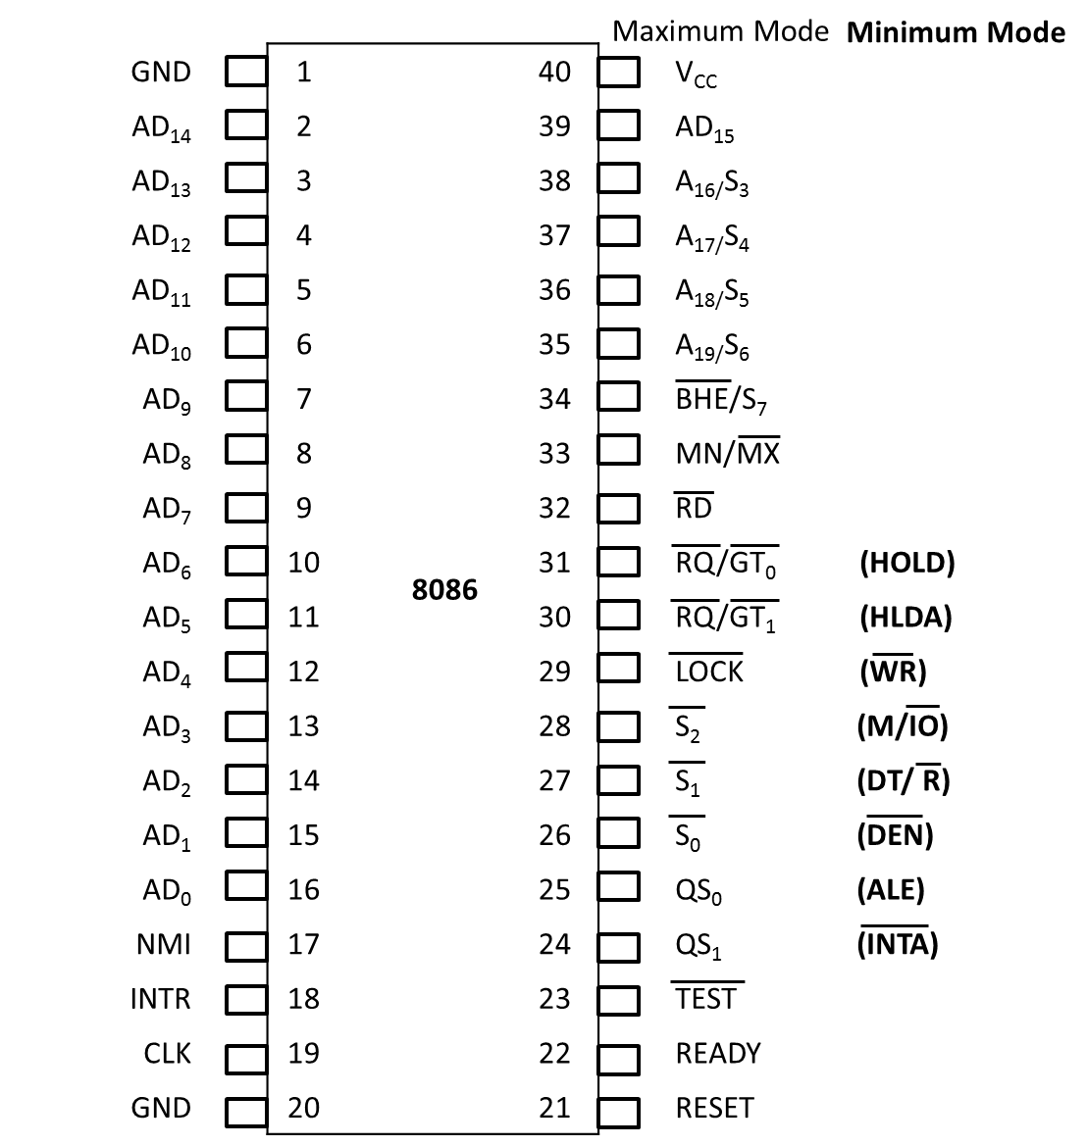
Address and Data pins: AD₀-AD₁₅ (bidirectional)
These lines are multiplexed bidirectional address/data bus.
AD₀-AD₇ carry lower order byte of data and AD₈-AD₁₅ carry higher order byte of data.
When ALE=1, then Address bus gets enabled, else Data bus will get enabled.

Slide 38
Address and Status pins:A₁₆/S₃- A₁₉/S₆
Lines are multiplexed and unidirectional address with status bus.
During T1, they carry higher order address.
In the remaining clock cycles, they carry status signals.
S₅ gives the status of Interrupt Flag (IF)
S₆ goes low, when 8086 controls the shared system bus.
S₃ and S₄ indicates the segment register.

Slide 39
Status pins
Below table indicates, which segment will be accessed on the basis of S₄ & S₃ bit value.
S₄ | S₃ | Register
0 | 0 | ES
0 | 1 | SS
1 | 0 | CS
1 | 1 | DS

Slide 40
BHE/S₇
BHE stands for Bus High Enable is active low output signal.
BHE signal is used to indicate the transfer of data over higher order data bus (D₈- D₁₅).
8-bit I/O devices use this signal.
S₇ is reserved for future development.

Slide 41
Interrupt Pins
NMI
It is an active high input signal.
It is a non-maskable interrupt signal.
INTR
It is an active high input signal
It is an interrupt request signal.
INTA
It is an active low output signal.
This is an interrupt acknowledge signal.

Slide 42
Clock Pin: CLK
Generates clock signals that synchronizes the operation of processor.
8086 clock frequency: 5MHz-10MHz

Slide 43
Clock Pin: RESET
Active high input signal.
When high, microprocessor enters into reset state and terminates all the activities of processor.
Processor requires 4 clock cycles to reset.
Thus, RESET signal must be 1 for at least 4 clock cycles.

Slide 44
Clock Pin: READY
Active high input signal.
This is an acknowledgement signal from I/O devices or memory.
When high, it indicates that device is ready to transfer data.
When low, microprocessor is in wait state.

Slide 45
Control Pin: Test
Active low input signal.
It is used to test the status of math coprocessor 8087.
The BUSY pin of 8087 is connected to this pin of 8086.
If low, execution continues, else microprocessor is in idle state.

Slide 46
Control Pin: MN/MX
8086 works in two modes:
Minimum Mode (Active high i/p signal)
Maximum Mode (Active low i/p signal)
Pins from 24 to 31 issue two different sets of signals.
One set of signals is issued when CPU operates in minimum mode, while other is issued when CPU operates in maximum mode.

Slide 47
Mode Multiplexed pins: S₂, S₁, S₀
S₂ | S₁ | S₀ | Indication
0 | 0 | 0 | Interrupt acknowledgement
0 | 0 | 1 | Read I/O
0 | 1 | 0 | Write I/O
0 | 1 | 1 | HALT
1 | 0 | 0 | Code Access
1 | 0 | 1 | Read Memory
1 | 1 | 0 | Write Memory
1 | 1 | 1 | Passive

Slide 48
Mode Multiplexed pins
DEN
Active low output signal.
This is a Data Enable signal, which is used to enable the transceiver.
DT/R
Data Transmit/Receive signal.
When high, data is transmitted out else when low, data is received in.

Slide 49
Mode Multiplexed pins: M/IO
This signal is issued by the microprocessor to distinguish memory access from I/O access.
When high, memory is accessed, else when low, I/O devices are accessed.

Slide 50
Mode Multiplexed pins: QS₁ and QS₀
QS₁ | QS₀ | Indication
0 | 0 | No operation
0 | 1 | First byte of opcode from queue
1 | 0 | Empty the queue
1 | 1 | Subsequent byte from queue

Slide 51
Mode Multiplexed pins
LOCK
Active low output signal.
This signal indicates that other processors should not ask CPU (8086) to hand over the system bus.
This pin is activated by using LOCK prefix to any instruction.
WR
Active low output signal.
Used to write data in memory or output signal, depending on status of M/IO signal.

Slide 52
Mode Multiplexed pins
HOLD
Active high input signal.
When DMA controller needs to use address/data bus, it sends a request to the CPU through this pin.
When microprocessor receives HOLD signal, it issues HLDA signal to the DMA controller.
HLDA
Active high Hold Acknowledgement output signal.
It is issued by 8086 after receiving HOLD signal.

Slide 53
Mode Multiplexed pins
RQ/GT₀ and RQ/GT₁
Request/Grant bi-directional pins.
Other processors request the CPU(8086) through these lines to release the system bus.
After receiving the request, CPU sends acknowledge signal through the same lines.
RQ/GT₀ has higher priority than RQ/GT_{1.}

Slide 54
Maximum Mode
Minimum Mode
GND |  | 1 | 8086 | 40 |  | V_{CC}
AD₁₄ |  | 2 |  | 39 |  | AD₁₅
AD₁₃ |  | 3 |  | 38 |  | A_{16/}S₃
AD₁₂ |  | 4 |  | 37 |  | A_{17/}S₄
AD₁₁ |  | 5 |  | 36 |  | A_{18/}S₅
AD₁₀ |  | 6 |  | 35 |  | A_{19/}S₆
AD₉ |  | 7 |  | 34 |  | BHE/S₇
AD₈ |  | 8 |  | 33 |  | MN/MX
AD₇ |  | 9 |  | 32 |  | RD
AD₆ |  | 10 |  | 31 |  | RQ/GT₀ (HOLD)
AD₅ |  | 11 |  | 30 |  | RQ/GT₁ (HLDA)
AD₄ |  | 12 |  | 29 |  | LOCK (WR)
AD₃ |  | 13 |  | 28 |  | S₂ (M/IO)
AD₂ |  | 14 |  | 27 |  | S₁ (DT/ R)
AD₁ |  | 15 |  | 26 |  | S₀ (DEN)
AD₀ |  | 16 |  | 25 |  | QS₀ (ALE)
NMI |  | 17 |  | 24 |  | QS₁ (INTA)
INTR |  | 18 |  | 23 |  | TEST
CLK |  | 19 |  | 22 |  | READY
GND |  | 20 |  | 21 |  | RESET
8086 Pin Diagram

Slide 55
GTU Exam Questions
Sr. | Questions | Marks | Year
1. | Explain the following pins of the 8086 microprocessor: TEST , LOCK , MN/MX. | 3 | W’17

Slide 56
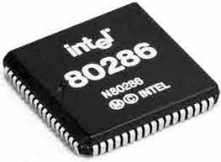
80286

Slide 57
80286
The Intel 80286 had a 24-bit address bus and was able to address up to 16 MB of RAM compared to 1 MB of its predecessor (8086).
It was designed for multi-user systems with multitasking applications, including communications and real-time process control.
80286 is the advanced microprocessors with memory management and protection abilities.
80286 have two operating modes namely real address mode and virtual address mode.
In real address mode, it can address up to 1MB of physical memory address like 8086.
In virtual address mode, it can address up to 16 MB of physical memory address space and 1 GB of virtual memory address space.
The performance of 80286 is five times faster than 8086.

Slide 58
80286 Architecture

Slide 59
80286 Architecture
ADDRESS UNIT
BUS UNIT
ADDRESS
LATCHES AND DRIVERS
A₀-A₂₃
80286 contains 4 separate processing units
Bus Unit (BU)
Instruction Unit (IU)
Address Unit (AU)
Execution Unit (EU)
BHE
PHYSICAL
ADDRESS
ADDER
M/IO
PREFETCHER
PROCESSOR
EXTENSION
INTERFACE
PEACK
SEGMENT
BASES
PEREQ
READY,
SEGMENT
LIMIT
CHECKER
SEGMENT
SIZE
BUS CONTROL
HOLD
S1,S0,
COD/INTA
LOCK,HLDA
DATA TRANSCEIVERS
OFFSET
ADDER
D₁₅-D₀
6-BYTE PREFETCH QUEUE
ALU
control
RESET
REGIS
TERS
CLK
3 DECODED INSTRUCTION QUEUE
INSTRUCTION DECODER
V_{SS}
V_{CC}
EXECUTION UNIT
INSTRUCTION UNIT
CAP
ERROR
INTR
BUSY
NMI

Slide 60
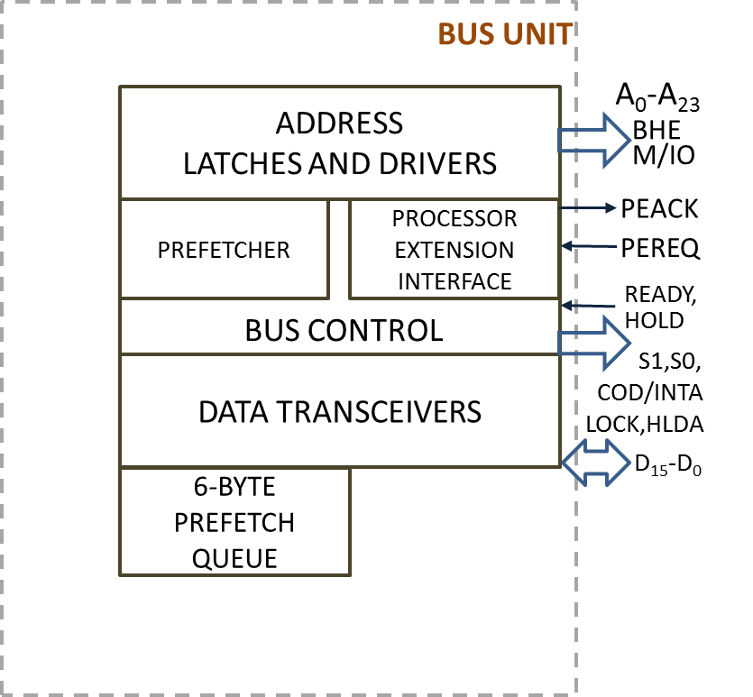
80286 Architecture: Bus Unit (BU)
Components:
Address Latches & Drivers
Bus Control
Instruction Pre-fetcher
Processor Extension Interface
Data Transceivers
6-byte Instruction Queue

Slide 61
80286 Architecture: Bus Unit (BU)
Functions:
Perform all memory, I/O read and write operations.
Pre-fetch the instruction bytes.
To control transfer of data to and from processor extension devices like 80287 math co-processor.
Whenever BU is not using the buses, it pre-fetches the instruction bytes and put them in 6 byte pre-fetch queue.
Take care of communication between CPU and a Co-processor.

Slide 62
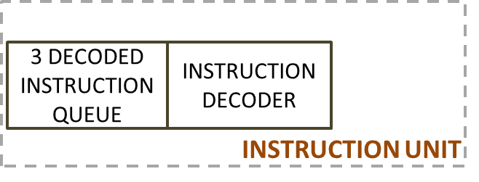
80286 Architecture: Instruction Unit (IU)
Components:
3 decoded instruction queue
Instruction decoder
Functions :
It fully decodes up to 3 pre-fetched instructions and holds them in a queue, so that Execution Unit (EU) can access them.
It helps processor to speed up by pipelining the instructions.

Slide 63
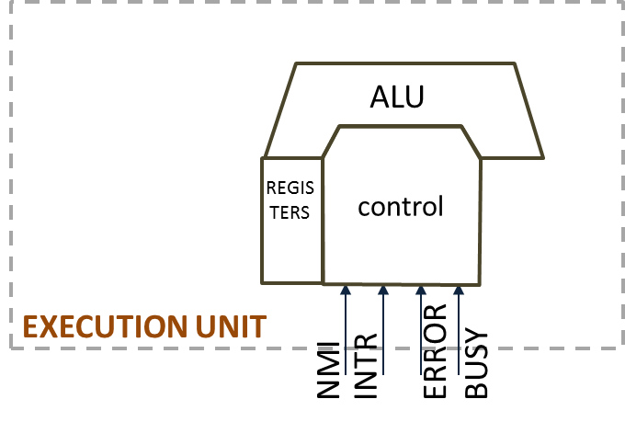
80286 Architecture: Execution Unit (EU)
Components:
It includes ALU, registers and control unit.
Registers are general purpose, index, pointer, flag registers and Machine Status Word (MSW).
Functions:
To sequentially execute instructions received from the instruction unit.
ALU result is either stored in registers or sent back over data bus.

Slide 64
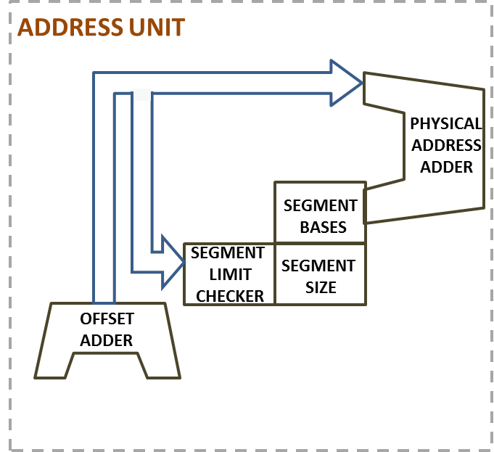
80286 Architecture: Address Unit
Components:
Segment Bases
Segment Limit Checker
Segment Size
Offset address
Physical address adder
Functions:
It computes physical address
that will be sent out to the memory
or I/O by Bus Unit (BU).
80286 operate in two different modes
1. Real address mode
2. Protected Virtual Address Mode.

Slide 65
80286 Architecture
ADDRESS UNIT
BUS UNIT
ADDRESS
LATCHES AND DRIVERS
A₀-A₂₃
80286 contains 4 separate processing units
Bus Unit (BU)
Instruction Unit (IU)
Address Unit (AU)
Execution Unit (EU)
BHE
PHYSICAL
ADDRESS
ADDER
M/IO
PREFETCHER
PROCESSOR
EXTENSION
INTERFACE
PEACK
SEGMENT
BASES
PEREQ
READY,
SEGMENT
LIMIT
CHECKER
SEGMENT
SIZE
BUS CONTROL
HOLD
S1,S0,
COD/INTA
LOCK,HLDA
DATA TRANSCEIVERS
OFFSET
ADDER
D₁₅-D₀
6-BYTE PREFETCH QUEUE
ALU
control
RESET
REGIS
TERS
CLK
3 DECODED INSTRUCTION QUEUE
INSTRUCTION DECODER
V_{SS}
V_{CC}
EXECUTION UNIT
INSTRUCTION UNIT
CAP
ERROR
INTR
BUSY
NMI

Slide 66
Register Organization of 80286

Slide 67
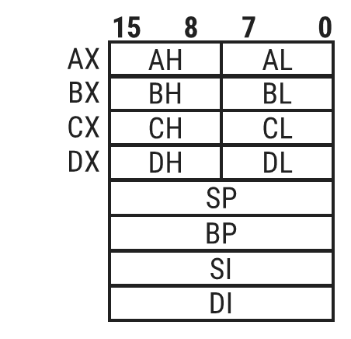
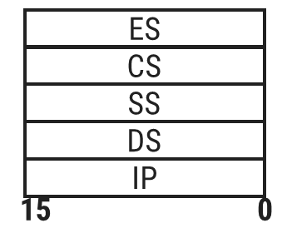
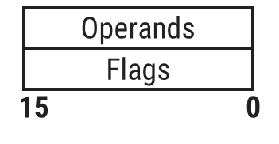
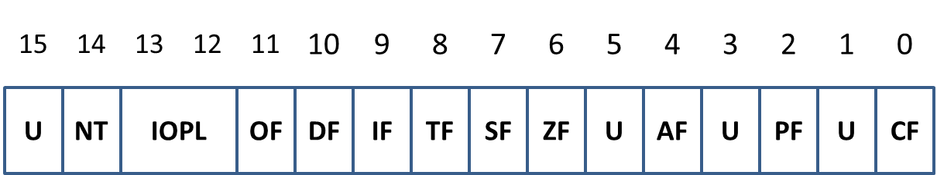
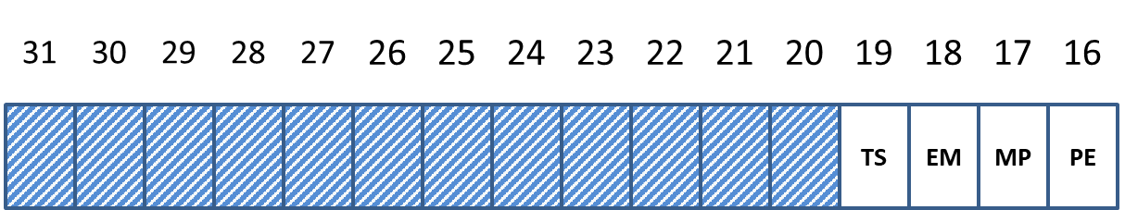
Register Organization of 80286
Eight 16-bit general purpose registers (AX, BX, CX, DX, SP, BP, SI, DI).
Four 16-bit segment registers (CS, SS, DS, ES).
16-bit Instruction Pointer (IP).
16-bit Flag Register.
Additionally, one new 16-bit Machine Status Word (MSW) register.
Flag Register
MSW

Slide 68
80286 Flag Register

Slide 69
80286 Flag Register
15
14
13
12
11
10
9
8
7
6
5
4
3
2
1
0
U
NT
IOPL
OF
DF
IF
TF
SF
ZF
U
AF
U
PF
U
CF
Nested Task (NT) flag
It is used in protected mode.
Bit is set when one task invokes another task.
Input Output Privilege Level flag (IOPL)
Used in protected mode operation to select the privilege level for I/O devices.
00, 01, 10 and 11 are various bits of privilege level; 00 is the highest and 11 is the lowest privilege level respectively.

Slide 70
80286 Flag Register: Machine Status Word (MSW)
31
30
29
28
27
26
25
24
23
22
21
20
19
18
17
16
TS
EM
MP
PE
Task Switch
TS is automatically SET whenever a task switch operation is performed.
EMulate processor extension flag
If SET, EMulate coprocessor bit is set to cause all coprocessor opcodes to generate a Coprocessor Not Available fault.
Monitor Processor extension
If SET, this flag allows WAIT instruction to generate a processor extension not present exception.
Used to indicate whether a processor extension (co-processor) is present in the system or not.
Protected Mode Enable
PE=1; Places 80286 in protected mode
PE=0; It can be only RESET by resetting CPU

Slide 71
Real Address Mode
80286

Slide 72
80286: Real Address Mode
Real Mode
Address Unit computes the address with segment base and offset like 8086.
Maximum physical space allowed in this mode is 1MB.
When 80286 get RESET, it always starts execution in real mode.
Task of 80286 in Real Mode
Initializes Instruction Pointer(IP) and other registers of 80286.
Initializes the peripheral.
Enable Interrupts.
Set up descriptor table.
Prepares for entering in PVAM (Protected Virtual Address Mode).

Slide 73
Physical Address calculation in Real Address Mode
Address Calculation
Total 1MB of Memory, divided among 16-segments with each of size 64kb.
80286 reserves two fixed areas for
System Initialization
IVT (Interrupt Vector Table)
15
0
0000
OFFSET
OFFSET
ADDRESS
15
0
SEGMENT SELECTION
0000
SEGMENT
ADDRESS
ADDER
IVT-1KB of Starting address | 00000H – 003FFH
System Initialization | FFFF0H – FFFFFH
20-BIT PHYSICAL MEMORY ADDRESS

Slide 74
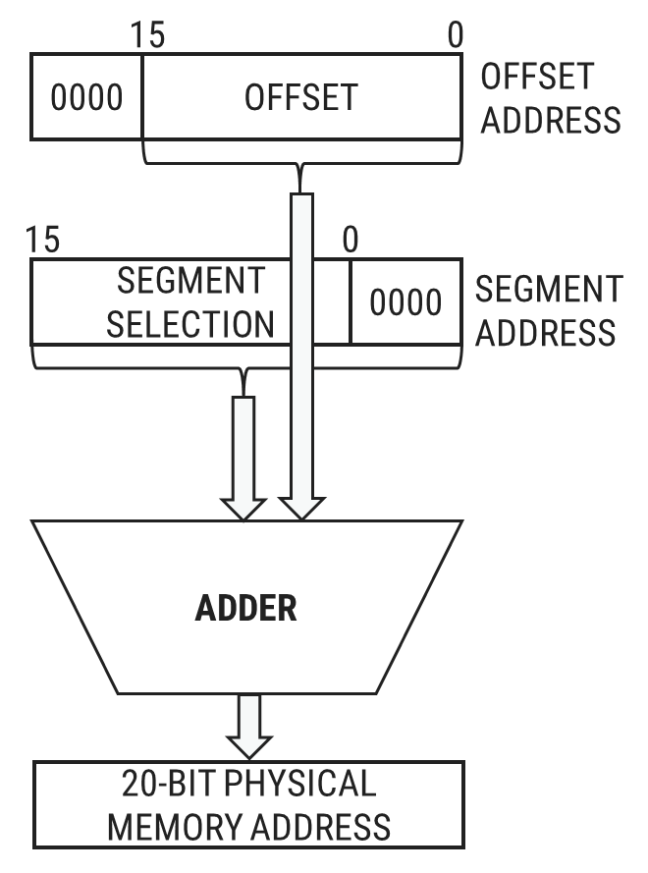
Physical Address calculation in Real Address Mode
Physical Address = Starting Address of Segment(20-bit) + Offset
EA = 2 2 2 2 0 H
OFFSET= + 0 0 8 F H
2 2 2 A F H
DS
2222 H
BYTE-0 | 22220 H
BYTE-1 | 22221 H
BYTE-N | 222AF H
OFFSET=008F H

Slide 75
Protected Virtual Address Mode
80286

Slide 76
What is the role of MMU?
Memory Management Unit (MMU) translates the virtual memory address into the physical memory address.
Virtual memory can be many times larger than physical memory.
Only programs that are currently required brought from the secondary storage such as a hard disk to the physical memory (RAM) for execution.
This is desirable as a microprocessor is supposed to store large programs and data can’t be accommodated in the physical memory space.

Slide 77
What is the role of MMU?
The hard disk is in the virtual or logical address space but not in the physical address space.
Faster memory such as RAM is used as the physical memory.
Before microprocessor executes a program, it checks whether the program is available in physical memory (RAM) or not.
If program is not available in the physical memory, it is brought from the secondary memory to the physical memory.
If available space is inadequate in the physical memory, some less important/unused program can be swapped back to the secondary memory to create space.

Slide 78
80286: Protected Virtual Address Mode
286 is the 1st processor to support the concept of Virtual Memory and Memory Management.
Here, the address unit acts as Memory Management Unit (MMU).
All 24 address lines are used and can access up to 16MB of physical memory.
If descriptor table scheme is used it can address up to 1GB of virtual memory.
The complete virtual memory is mapped with the 16MB of physical memory.
If a program is larger than 16MB, it is stored in the hard disk and will be executed by swapping as per sequence of execution.
The huge programs are divided in smaller segments or pages arranged in appropriate sequence.

Slide 79
Physical Address calculation in PVAM
PHYSICAL MEMORY
CPU
POINTER
SELECTOR
OFFSET
SEGMENT
MEMORY
OPERAND
PHYSICAL
ADDRESS
ADDER
SEGMENT
DESCRIPTOR
TABLE
SEGMENT
DESCRIPTOR
SEGMENT BASE ADDRESS
24-bit

Slide 80
Real mode vs PVAM
Real Address Mode | Protected Virtual Address Mode
Can only address up to 1MB of system memory and act as fast 8086. | Can address up to 16MB of System Memory.
Doesn’t Support the concept of Virtual Memory. | Supports the concept of Virtual Memory.
Real mode provides no support for memory protection, multitasking, or code privilege levels. | Protected mode provides support for memory protection, multitasking, or code privilege levels.
Initially every processor is in Real Mode i.e MSW PE-bit to 0. | Microprocessor will switch to PVAM mode by setting MSW PE-bit to 1.

Slide 81
80286 Privilege Level

Slide 82
80286 Privilege Level
11
Applications
(Lowest Privilege Level)
01
OS Service
00 Kernel Level
(highest)
10
OS Extension

Slide 83
PVAM : Selector

Slide 84
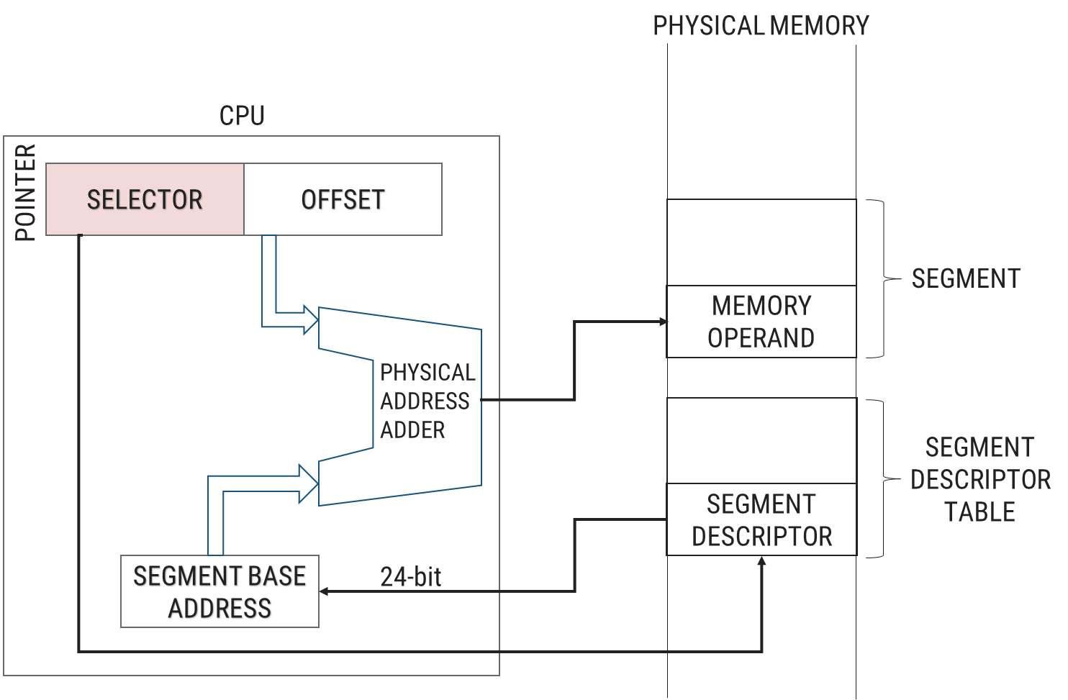
PVAM : Selector
TI-Table Indicator
TI=0 : GDT(Global Descriptor Table)
TI=1 : LDT(Local Descriptor Table)
15
14
13
12
11
10
9
8
7
6
5
4
3
2
1
0
Selector
TI
RPL
Bit 3-15 points to the Entry of Descriptor Table
00 | Kernel Level
01 | OS Services
10 | OS Extension
11 | Application Level

Slide 85
Segment Descriptor: PVAM Descriptor
80286

Slide 86
Segment Descriptor: PVAM Descriptor
This smaller segments or pages have been associated with data structure called a Descriptor.
It contains information of program segment or pages.
The data structure Descriptor is essentially one such identifier of particular program or segment.
The set of such descriptor arranged in a proper sequence describes the complete program.
Types of Segment Descriptor
Data Segment Descriptor | Used for Data Segment
Code Segment Descriptor | Used for Code Segment
System Segment Descriptor | Used for System Programs
Gate Segment Descriptor | Used for Subroutine and ISR

Slide 87
Descriptor Table
GDT & LDT

Slide 88
What is Descriptor Table?
Definition
The descriptor is a block of contiguous memory location containing information of a segment, like
i. Segment base address
ii. Segment limit
iii. Segment type
iv. Privilege level – prevents unauthorized access
v. Segment availability in physical memory
vi. Descriptor type
vii. Segment use by another task

Slide 89
Descriptor Table: GDT & LDT
A segment cannot be accessed, if its descriptor does not exist in either LDT (Local Descriptor Table) or GDT (Global Descriptor Table).
Set of descriptor arranged in a proper sequence describes the complete program.
Each Descriptor is 8-byte long.

Slide 90
Descriptor Table: GDT & LDT
The GDT contains information about segments that are global in nature, that is, available to all programs and normally used most heavily by the operating system.
The LDT contains descriptors that are application specific.
A global descriptor is also known as System Descriptor, and local descriptor is know as Application Descriptor.
The global descriptor table’s base address is stored in GDTR.
The local descriptor table’s base address is stored in LDTR.

Slide 91
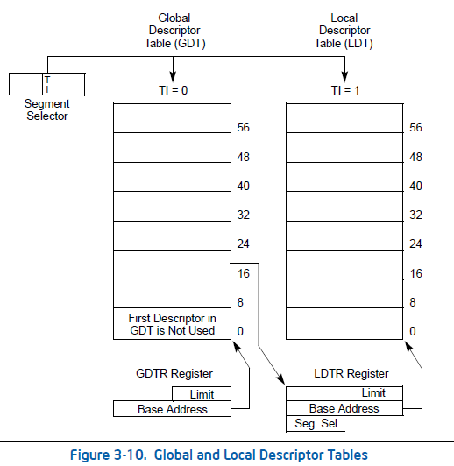
Descriptor Table: GDT & LDT

Slide 92
Differentiate GDT and LDT

Slide 93
Differentiate GDT and LDT
LDT (Local Descriptor Table), acts similar to GDT, which also saves segments descriptor.
The main differences between GDT and LDT is:
GDT have only one copy in system while LDT can have many.
GDT may not changed during execution, while LDT often changes when task switches.
Entry of LDT is saved in GDT.
Entries in GDT and LDT have the same structure.

Slide 94
Data/Code Segment Descriptor

Slide 95
Data/Code Segment Descriptor
15
8
7
0
7
INTEL RESERVED
8
5
P
DPL
S
TYPE
A
BASE ₂₃₋₁₆
6
3
BASE ₁₅₋₀
4
1
LIMIT ₁₅₋₀
2

Slide 96
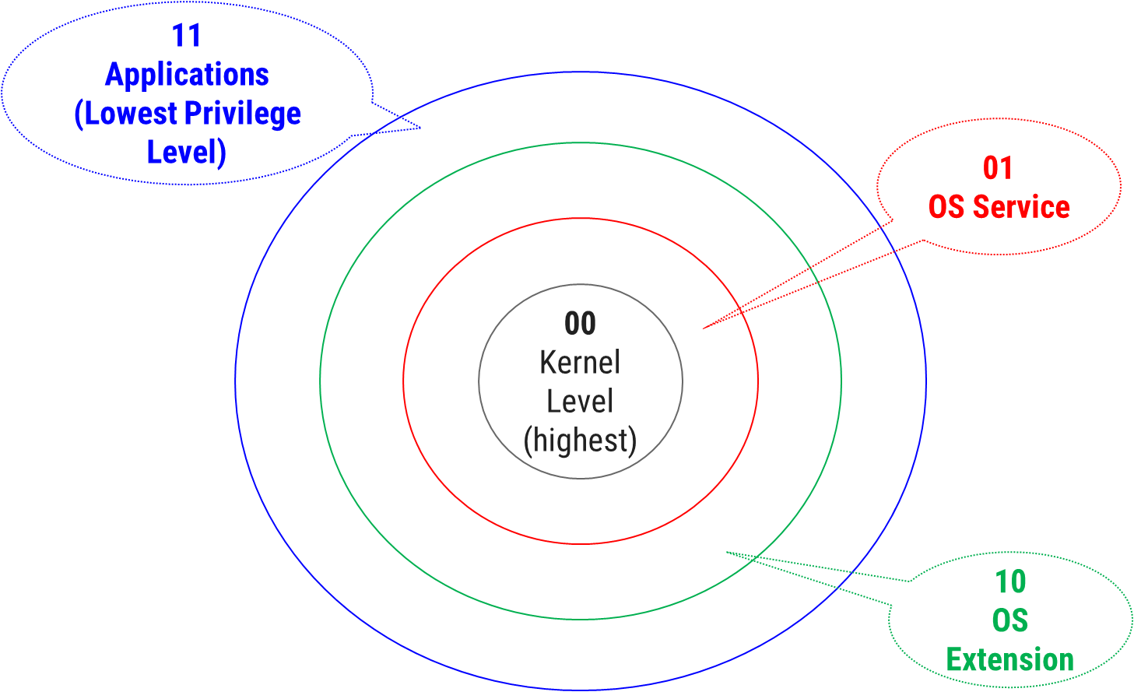
Data/Code Segment Descriptor
7 | 6 | 5 | 4 | 3 | 2 | 1 | 0
P | DPL | S | E | ED/C | R/W | A
Expansion Direction: Data Segment {when E=0}
ED=0 Segment expands upward (Data segment)
ED=1 Segment expands downward (Stack Segment)
Read : Code Segment
R=0 Code Segment execute only, not readable
R=1 Code Segment both executable & readable
Executable
E=0: Data Segment
E=1: Code Segment
TYPE
Accessed
A=0 Segment not accessed
A=1 Segment has been accessed
P=0: Descriptor is undefined, no mapping to physical memory exists.
P=1: Segment is mapped into physical memory.
Sets the Descriptor Privilege Level (DPL) necessary for protection
S=0: System descriptor(GDT)
S=1: Application Descriptor(LDT)
Conforming: Code Segment {when E=1}
C=0 Ignore DPL
C=1 Code segment will only be executed when
CPL > DPL
Write : Data Segment
W=0 Data segment not writable
W=1 Data segment writable

Slide 97
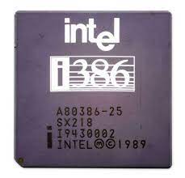
80386

Slide 98
80386: Introduction
80386 is 32-bit microprocessor.
Address Bus: 32-bit
Data Bus: 32-bit
Physical memory : 4GB
Virtual memory : 64TB
80386 supports variety of operating clock frequency, which are 16 MHz, 20 MHz, 25 MHz and 33 MHz.
80386 supports 3 operating modes: real, protected and virtual real mode.
Key characteristics: Multitasking and protection capability.
80386 has an internal dedicated hardware that permits multitasking.
3 stage pipeline: fetch, decode and execute.
it supports simultaneous fetching, decoding and execution inside the system.

Slide 99
80386 Architecture

Slide 100
80386 Architecture
Execution Unit
Segment Unit
Paging Unit
Segment
Descriptor
Cache
Page
Descriptor
Cache
Register File
Barrel Shifter
ALU
Segment Unit
Page Unit
Instruction Queue
Pre-fetch Queue
Pre-fetch
Unit
BUS UNIT
Instruction Unit
Instruction Decoder Unit
Code Pre-fetch Unit
Bus Interface Unit

Slide 101
Bus Interface Unit
The Bus Interface Unit connects 80386 with memory and I/O.
Based on internal requests for fetching instructions and transferring data from the code pre-fetch unit, 80386 generates the address, data and control signals for the current bus cycles.
BUS UNIT
Bus Interface Unit

Slide 102
Code Pre-fetch Unit
The code pre-fetch unit pre-fetches instructions when the bus interface unit is not executing the bus cycles.
It then stores them in a 16-byte instruction queue for decoding by the instruction decode unit.
Pre-fetch Queue
Pre-fetch
Unit
Code Pre-fetch Unit

Slide 103
Instruction Decoder Unit
The Instruction Decoder Unit translates instructions from the pre-fetch queue into micro-codes.
The decoded instructions are then stored in an instruction queue (FIFO) for processing by the execution unit.
Instruction Queue
Instruction Unit
Instruction Decoder Unit

Slide 104
Execution unit
Execution unit has 8 General purpose registers which are either used for handling data or calculating offset addresses.
The execution unit processes the instructions from the instruction queue.
It contains a control unit, a data unit and a protection test unit.
The barrel shifter increases the speed of all shift and rotate operations.
Execution Unit
Register File
Barrel Shifter
ALU

Slide 105
Segment Unit
The segment unit calculates and translates the logical address into linear addresses at the request of the execution unit.
Segment Unit
Segment
Descriptor
Cache
Segment Unit

Slide 106
Paging Unit
The translated linear address is sent to the Paging Unit.
Upon enabling the paging mechanism, the 80386 translates these linear addresses into physical addresses.
If paging is not enabled, the physical address is identical to the linear address and no translation is required.
Paging Unit
Page
Descriptor
Cache
Page Unit

Slide 107
80386 Architecture
Execution Unit
Segment Unit
Paging Unit
Segment
Descriptor
Cache
Page
Descriptor
Cache
Register File
Barrel Shifter
ALU
Segment Unit
Page Unit
Instruction Queue
Pre-fetch Queue
Pre-fetch
Unit
BUS UNIT
Instruction Unit
Instruction Decoder Unit
Code Pre-fetch Unit
Bus Interface Unit

Slide 108
80386 Register Organization

Slide 109
80386 Register Organization
31
0
SEGMENT REGISTER
EAX |  | AX
EBX |  | BX
ECX |  | CX
EDX |  | DX
ESP |  | SP
EBP |  | BP
ESI |  | SI
EDI |  | DI
ACCUMULATOR
CS
SS
DS
ES
FS
GS
BASE INDEX
COUNT
DATA
Data Segment
STACK POINTER
BASE POINTER
SOURCE INDEX
15
0
DESTINITION INDEX
31
0
EIP |  | IP
EFLAGS |  | FLAGS

Slide 110
80386 Register Organization: Flag Register
15
14
13
12
11
10
9
8
7
6
5
4
3
2
1
0
U
NT
IOPL
OF
DF
IF
TF
SF
ZF
U
AF
U
PF
U
CF
31
30
29
28
27
26
25
24
23
22
21
20
19
18
17
16
RF
VM
Resume Flag
It is used in conjunction with the debug register breakpoints.
When RF is set(1), it causes any debug fault to be ignored on the next instruction.
The RF flag temporarily disables debug exceptions so that an instruction can be restarted.
RF is then automatically reset at the successful completion of every instruction.
Virtual Mode Enable
When VM=1; 386 will switch from Protected to virtual mode

Slide 111
Operating Modes of 80386
Real Address Mode
Protected Virtual Address Mode
Virtual Mode

Slide 112
80386: Real Address Mode
When 80386 resets, the initial operating mode is Real Address Mode.
In real address mode, 80386 works as a fast 8086 with 32-bit registers and data types.
Real-address mode is in effect after a signal on the RESET pin.
Even if the system is going to be used in protected mode, the start-up program will execute in real mode temporarily while initializing for protected mode.
The addressing techniques, memory size, interrupt handling in this mode of 80386 are similar to the real addressing mode of 80286.
In real address mode, the default operand size is 16-bit but 32-bit operands and addressing modes may be used with the help of override prefixed instructions.
Maximum physical memory = 1MB.

Slide 113
80386 :PVAM
MMU operates similar to 80286.
Virtual addresses are represented with a selector component and an offset component.
The selector component is used to index a descriptor in a descriptor table.
The descriptor contains the 32-bit physical base address for the segment.
The offset part of the virtual address is added to the base address to produce the actual physical address.
The offset part of a virtual address can be 16-bit or 32-bit, so segment can be as large as 4GB.
Hence the virtual memory size is 64TB.

Slide 114
Operating Modes of 80386 :PVAM
Advantage of segmentation of memory: Segments corresponds to code and data structures in the program. Hence segmentation is useful.
Limitation of segmentation of memory: If we need only a part of memory, even then we have to swap the whole segment content. This will increase the time for execution.

Slide 115
80386:Virtual Mode
Virtual Mode (Paged Mode)
In virtual mode, 8086 can address 1MB of physical memory that may be anywhere in the 4Gbytes address space of the protected mode of 80386.
In this mode, instead of segments, 4KB of fixed page length are used.

Slide 116
80386:Virtual Mode
Total memory available for paging = 1MB = 1024KB
Size of one page = 4KB
How many pages can be addressable with 1MB of memory?
Total pages= 1024KB/4KB = 256 pages(4KB each)
Paged Mode
Limitation : Pages do not correspond to the logical structure of the program.
Advantage : Pages can be quickly swapped.

Slide 117
80386 Memory Access in Virtual Mode

Slide 118
80386 Memory Access in Virtual Mode
Selector
Segmentation
Mechanism
Paging
Mechanism
Linear Address
Physical Address
Offset

Slide 119
Operating Modes of 80386:VM
Page Directory Entry
Each directory entry is of 4 byte
31
12
11
10
9
8
7
6
5
4
3
2
1
0
Page Table Address
(A₃₁-A₁₂)
Reserved
0
0
D
A
0
0
U/S
R/W
P
The upper 20-bit (A₃₁-A₂₁) are used to select 1024 page table entries. Page Tables can be shared between the task.
P: Present bit
P=0, indicates entry cannot be used for address translation.
P=1, indicates entry can be used for address translation. P-bit of currently executed page is always high.
D: Dirty bit
Dirty bit is set before any write operation to the page.
Dirty bit are undefined for page directory entries.
A :Accessed bit is set by 80386 before any access to the page
A = 0, page is not accessed.
A = 1, page is accessed.
U/S | R/W | Permitted for Level 3 | Permitted for Level 2,1 or 0
0 | 0 | None | Read/Write
0 | 1 | None | Read/Write
1 | 0 | Read-only | Read/Write
1 | 1 | Read-Write | Read/Write

Slide 120
Operating Modes of 80386:VM
Page Table Entry
Each page table is of 4KB in size and contain maximum 1024 pages.
31
12
11
10
9
8
7
6
5
4
3
2
1
0
Page Frame Address
(A₃₁-A₁₂)
Reserved
0
0
D
A
0
0
U/S
R/W
P
The upper 20-bit (A₃₁-A₁₂) are used to select 1024 page entries. Page Tables can be shared between the task.
P: Present bit
P=0, indicates entry cannot be used for address translation.
P=1, indicates entry can be used for address translation. P-bit of currently executed page is always high.
D: Dirty bit
Dirty bit is set before any write operation to the page.
Dirty bit are undefined for page directory entries.
A :Accessed bit is set by 80386 before any access to the page
A = 0, page is not accessed.
A = 1, page is accessed.
U/S | R/W | Permitted for Level 3 | Permitted for Level 2,1 or 0
0 | 0 | None | Read/Write
0 | 1 | None | Read/Write
1 | 0 | Read-only | Read/Write
1 | 1 | Read-Write | Read/Write

Slide 121
Page Translation Mechanism in 80386

Slide 122
Page Translation Mechanism in 80386
Format of Linear Address
A linear address refers indirectly to a physical address by specifying a page table, a page within that table, and an offset for that page.
31
22
21
12
11
0
DIRECTORY | TABLE | OFFSET

Slide 123
31
22
21
12
11
0
Linear Address
DIRECTORY | TABLE | OFFSET
USER MEMORY
80386
+
Memory
31
PAGE TABLE
0
31
DIRECTORY
0
+
+
CONTROL
REGISTERS
CR3
80386:Page Translation Mechanism

Slide 124
80386:Page Translation Mechanism
CR3: Enables processor to translate linear addresses into physical addresses by locating the page directory and page tables for the current task.
Here processor converts the DIRECTORY, TABLE, and OFFSET fields of a linear address into the physical address by consulting two levels.

Slide 125
GTU Exam Questions
Sr. | Questions | Marks | Year
1. | Explain the paging mechanism in an 80386 microprocessor. | 7 | S’18 S’19
2. | What is a descriptor table? What is its use? Differentiate between GDT and LDT. | 4 | S’18 S’19
3. | Differentiate 80286 with 80386 microprocessor. | 7 | S’18
4. | Explain the real mode and protected mode of the 80286 microprocessor. | 7 | W’17 S’19
5. | Briefly explain the architecture of the 80386 microprocessor. | 4 | W’17

Slide 126
Comparison of different Intel Processors

Slide 127
Comparison of different Intel Processors
Parameter | 8085 | 8086 | 80286 | 80386 | 80486 | Pentium
N-bit Processor (data bus) | 8-bit | 16-bit | 16-bit | 32-bit | 32-bit | 64-bit
Address bus | 16-bit | 20-bit | 24-bit | 32-bit | 32-bit | 32-bit
Addressable Memory | 64KB | 1MB | 16MB | 4GB | 4GB | 4GB
Introduced in Year | 1976 | 1978 | 1982 | 1985 | 1989 | 1993
Support Virtual Memory | NO | NO | YES | YES | YES | YES
Support Segmentation | NO | YES | YES | YES | YES | YES
Supports Paging | NO | NO | NO | YES | YES | YES
Operating Modes | 1 | 2 | 3 | 3 | 3 | 3
Support Cache Memory | NO | NO | NO | NO | YES | YES
Contains on-chip FPU | NO | NO | NO | NO | YES | YES
Supports Instruction Queue | NO | YES | YES | YES | YES | YES

Slide 128

References
Books: | Advanced Microprocessors, Daniel Tabak, McGrawHill
 | 8086 Programming and Advance Processor Architecture, Savaliya M. T., WileyIndia
 | The 8088 and 8086 Microprocessors, Triebel & Singh, Pearson Education
Mobile Application: | 8085 and 8086 Microprocessor Opcodes app from Play Store: http://tiny.cc/aopcodes

Slide 129
Thank You

